Slide 1

PREDICTING Attrition a driver for creating Value, realizing Strategy and refining key HR Processes
Team Members:
Kevin Mendonsa, Maureen Stolberg, & Vivek Viswanathan
Advisor:
Scott Crum, Chief Human Resources Officer, MSCI, Inc.
Notes:
Good morning everyone and thank you for being here today. My name is Maureen Stolberg and on behalf of my team, we look forward to discussing how predicting attrition can become a driver for creating Value, realizing Strategy and refining key HR Processes.
Our team is comprised of myself, Kevin Mendonsa, Vivek Vanswathan, & our Advisor,
Scott Crum who is currently the Chief Human Resources Officer for Morgan Stanley Capital International, or more commonly known as MSCI.
Now lets get started.

Slide 2
In a knowledge driven economy, people or human capital are emerging as the key competitive differentiator in today’s “war for talent”.
Strategically managed attrition is good
Losing skilled, knowledgeable and trained employees severely impacts a company’s productivity, innovation, performance and shareholder value
Understanding the drivers of attrition are crucial to address underlying organizational issues and develop remediating strategies.
​
Notes:
Employee attrition while not avoidable is good for an organization. It needs to be strategically managed, so the right talent is retained.
Retaining top talent and making room for new talent is key to any organization's growth, innovation and market success.
Represents 70% of the costs in most businesses and almost 90% in knowledge and service-based businesses
In a knowledge driven economy, people or human capital are emerging as the key competitive differentiator
Employee retention is even more critical in today’s “war for talent”
Losing skilled, knowledgeable and trained employees severely impacts a company’s productivity, innovation, performance and shareholder value

Slide 3

PROBLEM STATEMENT

Slide 4
The aim of this study is to provide a framework for maximizing a retention strategy’s ROI by leveraging insights derived from predicting attrition to prioritizing retention investments.
Objective 1:
Identify which employees are at risk of leaving and determine the key factors that drive their decision.
Objective 2:
Use the results generated from the predictive model to maximize retention investment value by strategically managing attrition and optimizing costs.
Notes:
Employee attrition while not avoidable is good for an organization. It needs to be strategically managed, so the right talent is retained.
Retaining top talent and making room for new talent is key to any organization's growth, innovation and market success.
Represents 70% of the costs in most businesses and almost 90% in knowledge and service-based businesses
In a knowledge driven economy, people or human capital are emerging as the key competitive differentiator
Employee retention is even more critical in today’s “war for talent”
Losing skilled, knowledgeable and trained employees severely impacts a company’s productivity, innovation, performance and shareholder value

Slide 5
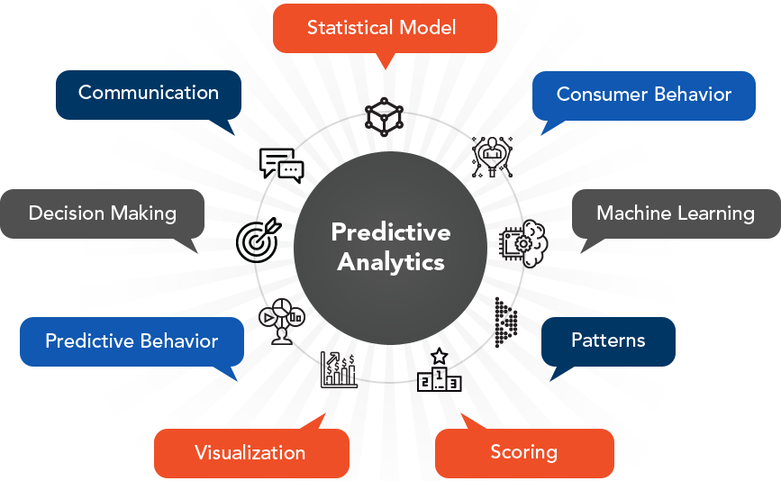
MODEL APPROACHES & EVALUATION
Notes:
Let’s move on to review the model approaches and evaluation parameters.

Slide 6
Data pre-processing: Data Imputation, one hot encoding, Scaling, Checking for correlation, Up-sampling (SMOTE)​
Feature Reduction: Feature ranking with recursive feature elimination and cross-validated selection of the best number of features​
Model Techniques: Logistic Regression, SVM, Naïve Bayes, KNN, Decision Tree and Random Forests, Ensemble Models (Vecstack, StackingCVClassifier, StackingClassifier, VotingClassifier)​
Parameter Selection: Randomized search on hyper parameters –RandomizedSearchCV.​
Notes:
Data we used for our analysis was sourced from the HR Information System of company X. The data was anonymized and imputed at source.
We performed up-sampling and scaling followed by feature importance analysis (and elimination). Understanding the features that influence attrition helps the organization curb attrition rate and retain high value employees.
From our discussions with the organization, our primary focus was to correctly identify all the high-value employees who were at risk of leaving the organization. We executed 13 different models and compared the performance on Recall, Precision and AUC Score.
6 of these models were ensemble models. The models were executed with a combination of Full features, reduced features, default parameters and best parameters. We used Randomized Search to identify the best model parameters.

Slide 7

MODEL EFFECTIVENESS:
INFERENCE
Notes:
Next, a quick insight into the results

Slide 8
MODEL EFFECTIVENESS: INFERENCE
Notes:
As discussed in the previous section, our primary focus was to reduce the False Negatives. Our models were focused on maximizing the recall score.
Though the Gaussian Naïve Bayes had the best recall score, it had the worst accuracy and precisions scores.
In general, the Ensemble models performed better than the independent models.
XGBoost was marginally behind Stacking Ensemble model in terms of AUC & recall score but had a better precision score.
The performance of the Random Forest model was comparable to the top 3 ensemble models and the XGBoost.
Logistic Regression had a good AUC Score but both the precision and recall scores were lower than 0.8.

Slide 9
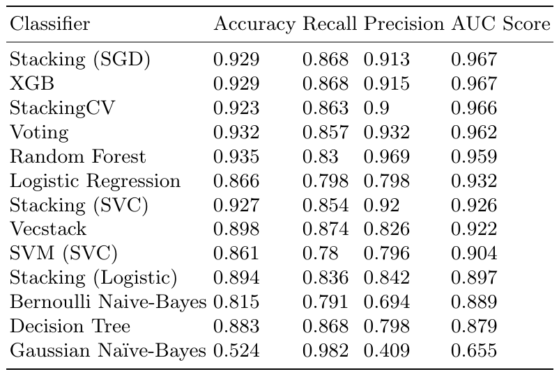
Gaussian Naïve Bayes had the least false negatives but had a bad accuracy and precision scores.
The Ensemble models performed better than the independent models.
Performance of Random Forest and XGBoost models were comparable to the Ensemble models.​
Notes:
As discussed in the previous section, our primary focus was to reduce the False Negatives. Our models were focused on maximizing the recall score.
Though the Gaussian Naïve Bayes had the best recall score, it had the worst accuracy and precisions scores.
In general, the Ensemble models performed better than the independent models.
XGBoost was marginally behind Stacking Ensemble model in terms of AUC & recall score but had a better precision score.
The performance of the Random Forest model was comparable to the top 3 ensemble models and the XGBoost.
Logistic Regression had a good AUC Score but both the precision and recall scores were lower than 0.8.

Slide 10
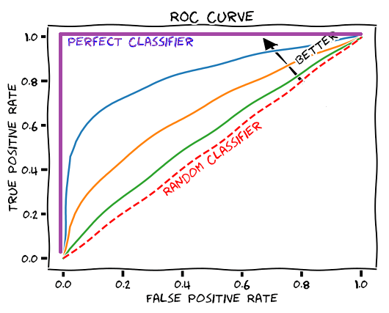
AUC Score
Notes:
Let’s dive deeper into the ROC-AUC curves

Slide 11
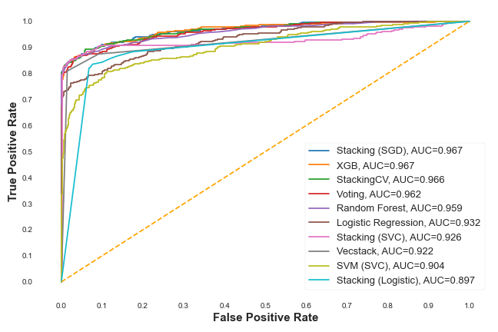
Top-5 models had an AUC score greater than 0.95​
Notes:
ROC-AUC is one of the most important evaluation metrics for checking any classification model’s performance.
Higher the AUC, better the model is at distinguishing between employees likely to resign vs. continue to stay with the organization.
Models with 0.9 or better ROC-AUC score are generally said to be able to provide outstanding classification of the target variable.
9 of our top 10 models had a ROC-AUC score greater than 0.9.

Slide 12
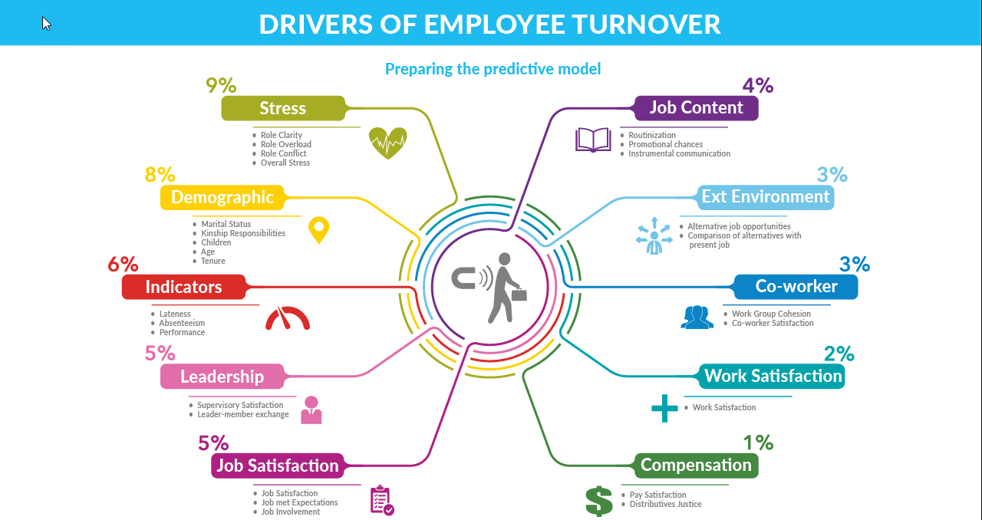
FEATURE IMPORTANCE

Slide 13
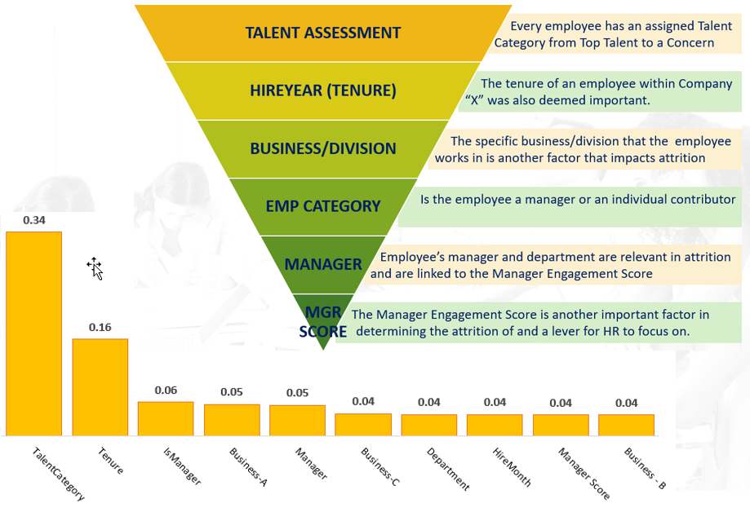
MANAGING WHAT MATTERS MOST!!!
Notes:
Categorizing talent is a very important and sacred exercise within the firm that involves the highest levels of leadership. It is taken extremely seriously and the entire reward structure is built around this principle. By stratifying talent in the firm, it indicates not only which roles are critical but also the talent that occupies it and their significance to creating value for the firm.
Our model also indicated that Tenure is important. This is an important fine because it indicates to the HR department that they need to better understand why individuals within a certain bucket are more likely to leave. It could be for a number of reasons from development and training to more challenging assignments.
The business or division that the employee works for is also quite important as it indicates which businesses motivate employees and which don’t. Additionally, it could be a number of factors in that business that could be causing greater turnover and needs immediate investigation and remediation.
The saying employee’s leave manager’s and not companies still holds true. Employee’s join a company but leave a manager. Therefore having high managerial and leadership principles for the firm’s managers is critical in curtailing attrition. Developing and training new managers and experienced managers in modern management principles are important to address attrition. With changing demographics of the workforce, new management ideas are critically important to maintain a motivated and engaged workforce. This is the essence of the Manager Engagement Scorecard another factor that is important in the model.

Slide 14
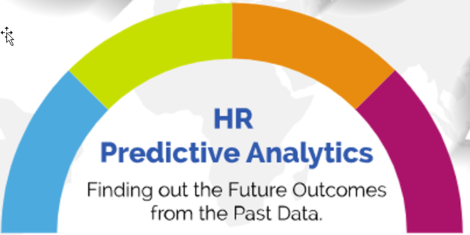
Top Grade Talent
Retention Investment ROI
Reduce Time to Fill and Hiring costs
Maximize Retention Strategies and ROI
Manage Attrition
Forecasting
Transform attrition from a lagging to a leading indicator
Be Proactive and minimize resignations
MANAGING
FUTURE OUTCOMES FROM PAST DATA
conclusion

Slide 15
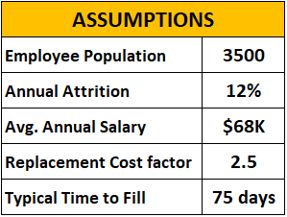
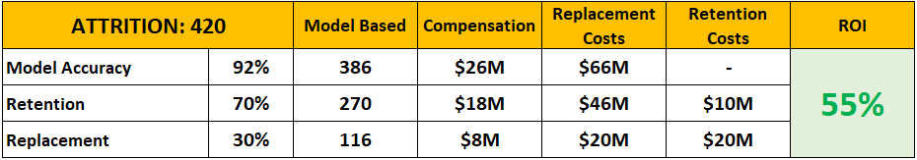
Maximize retention strategy’s ROI by leveraging insights derived from predicting attrition and prioritizing retention investments
Using conservative assumptions for Company X
Current attrition @ 12% is approximately 420 terms
Based on model accuracy of 92% the Retention ROI for Company X is 55% returns.
Company X can develop talent pipelines for expected departures further reducing the Time to Fill and subsequently the Cost of Hire resulting in additional savings.
The combined savings and ROI enables Company X to “Top Grade” backfilled roles and bring higher skilled talent into the firm to augment its top talent pool.
Notes:
The primary goal of this project was to develop a framework to Maximize retention strategy’s ROI by leveraging insights derived from predicting attrition and prioritizing retention investments
Enables Company "X" to transition from using attrition as a "lagging" indicator to a ”leading” indicator and employ mitigating retention strategies and talent pipelines to address predicted attrition and reduce time to fill metrics.
Predictive models provide key insight into which factors and features are important as levers for HR departments to control and manage attrition.
It is recommended that Company “X” include additional factors to further determine what other levers are available to proactively address attrition.
Cost to fill a job is approximately 2.5 times the compensation for that role. Using retention strategies will significantly reduce cost while retaining superstars
Knowing who is likely to leave will also permit development of a talent pipeline that reduces the time to fill for much needed roles. Furthermore it allows for “TOP GRADING” of talent in the firm where low/mediocre performers are nudged to leave to make room for new talent and new superstars. This is a game changer for a firm.
Knowing the factors that drive attrition enables organizations to develop strategies to better focus on them and more effectively manage them proactively versus retroactively
For this study we were able to obtain limited but real data. It is highly recommended to Company “X” to add additional factors that will further enhance the model and provide greater insights.

Slide 16
Q & A

Slide 17
THANK
YOU

